Slide 1
AI-Driven Plant Disease Detection for Smart Agriculture Using CNN
Presented By:
Md Fariyaz Rahaman – CSE224030
Imatj Ali – CSE224033
Under the Guidance :
Dr. Zeenat Rehena
Department Of Computer Science & Engineering
Aliah University

Slide 2
Contents
Introduction
Challenges
Objectives
Literature Survey
Dataset Description
Model Description
Flowchart
Work Process
Result & Discussion
Conclusion
References

Slide 3
Introduction
Plant diseases are a major cause of crop loss and reduced agricultural productivity.
Traditional disease detection methods rely on manual inspection, which can be time-consuming and prone to errors.
Deep Learning techniques, especially Convolutional Neural Networks (CNNs), enable accurate and automated plant disease detection.
This project develops a Plant Disease Recognition System using a CNN model trained on plant leaf images from the Kaggle dataset.
A Flask-based web application allows users to upload leaf images and receive disease predictions along with causes and treatment recommendations.

Slide 4
Challenges
mage quality and lighting conditions can affect prediction accuracy.
Similar disease symptoms may lead to classification challenges.
Model performance depends on the quality and diversity of the training dataset.
The system can only detect diseases included in the trained dataset.
Real-world images may reduce prediction accuracy compared to dataset images.

Slide 5
Objective
To design and develop a Convolutional Neural Network (CNN)-based Plant Disease Recognition System capable of accurately detecting and classifying healthy and diseased plant leaves using image data collected from the Kaggle dataset.
To develop a user-friendly Flask web application that allows users to upload plant leaf images, receive real-time disease predictions, and obtain disease-related information, causes, and treatment recommendations to support effective crop management and decision-making.

Slide 6
Literature Survey
Sl. No. | Author(s) | Paper Title | Method Used | Year
1 | Dubey et al. | Detection and Classification of Apple Fruit Diseases Using Local Binary Patterns | Image Processing + SVM | 2014
2 | Revathi et al. | Classification of Cotton Leaf Spot Diseases Using Image Processing Techniques | Image Processing + ANN | 2012
3 | Pujari et al. | Detection of Plant Diseases Using Image Processing Techniques | Image Processing + KNN | 2015
4 | Kamble et al. | Crop Disease Detection Using Convolutional Neural Networks | CNN | 2018
5 | Patil et al. | Plant Disease Detection Using Deep Learning Techniques | CNN | 2019

Slide 7
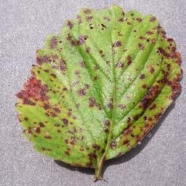
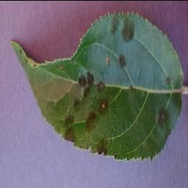
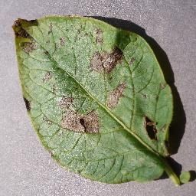
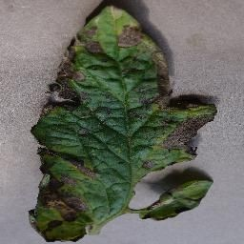
Dataset Description
Dataset :- PlantVillage Dataset
Source: https://www.kaggle.com/datasets/abdallahalidev/plantvillage-dataset
Images count: 54.00K
Type: RGB(color) Classes: 38

Slide 8
Dataset Description
The PlantVillage dataset is a publicly available collection of plant leaf images used for disease detection.
It contains over 54,000 RGB images from 14 different crop species such as apple, potato, tomato, and grape.
The dataset includes 38 disease classes, covering both healthy and diseased plant leaves.
Images are captured under controlled conditions with uniform backgrounds.
The dataset is suitable for training and evaluating deep learning models like CNNs.

Slide 9
Model Description
CNNs are deep learning models designed for image processing tasks.
They automatically learn features like edges, textures, shapes, and disease patterns.
The dataset was split into 43,456 training images and 10,849 validation images (80:20).
The CNN model uses two convolutional layers with ReLU activation for feature extraction.
Max-pooling layers reduce image size and computational cost.
Fully connected layers perform accurate multi-class plant disease classification.

Slide 10
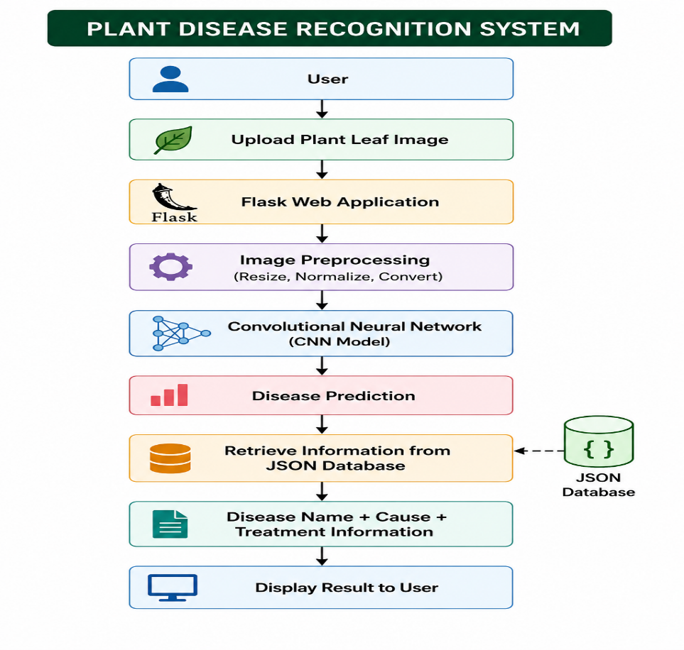
Flowchart

Slide 11
Work Process
Leaf images are collected from the PlantVillage dataset containing healthy and diseased plant samples.
Dataset Collection
Images are resized, normalized, and split into training and validation datasets.
Data Preprocessing
CNN Model Training
A Convolutional Neural Network (CNN) is designed and trained to learn disease-related features from leaf images.
The trained model is evaluated using validation accuracy and loss.
Model Evaluation
Web Application Development
A Flask-based web application is developed to upload leaf images and display disease prediction results in real time.

Slide 12
Result & Discussion(Cont.)
After training for 16 epochs, the model achieved a validation accuracy of 96%, indicating strong classification performance.
The decreasing validation loss (0.7252) confirms good generalization and reduced overfitting.
Training and Validation Accuracy and Loss
Evaluation Phase | Loss | Accuracy
Initial (Baseline) | 3.72 | 2.00%
Final Training (Epoch 16) | 0.0308 | 97.51%
Final Validation (Epoch 16) | 0.0736 | 96.42%
Final Testing (Unseen Data) | 0.0604 | 96.45%
Model Performance Summary

Slide 13
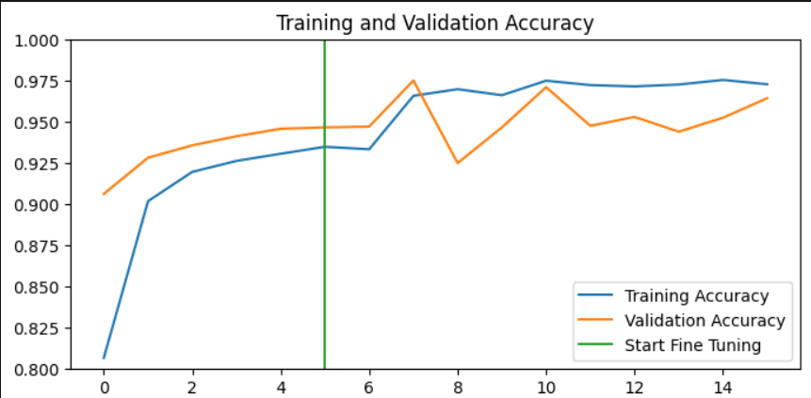
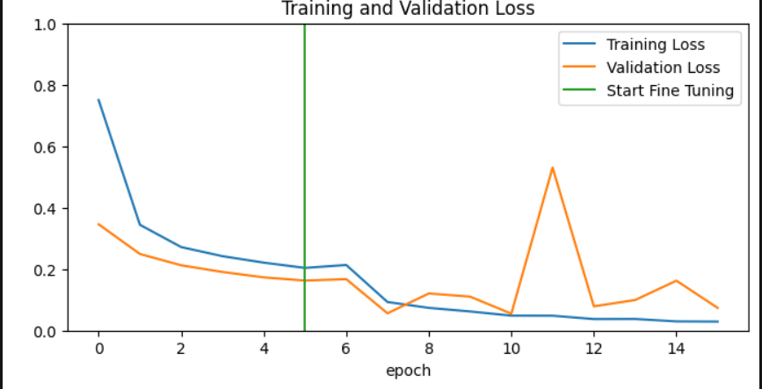
Result & Discussion(Cont.)
training & validation accuracy values
training & validation loss values
The training and validation accuracy increase steadily across epochs, indicating effective learning by the CNN model.
The validation accuracy closely follows training accuracy, showing minimal overfitting.
The decreasing loss curves confirm improved model convergence and generalization.

Slide 14
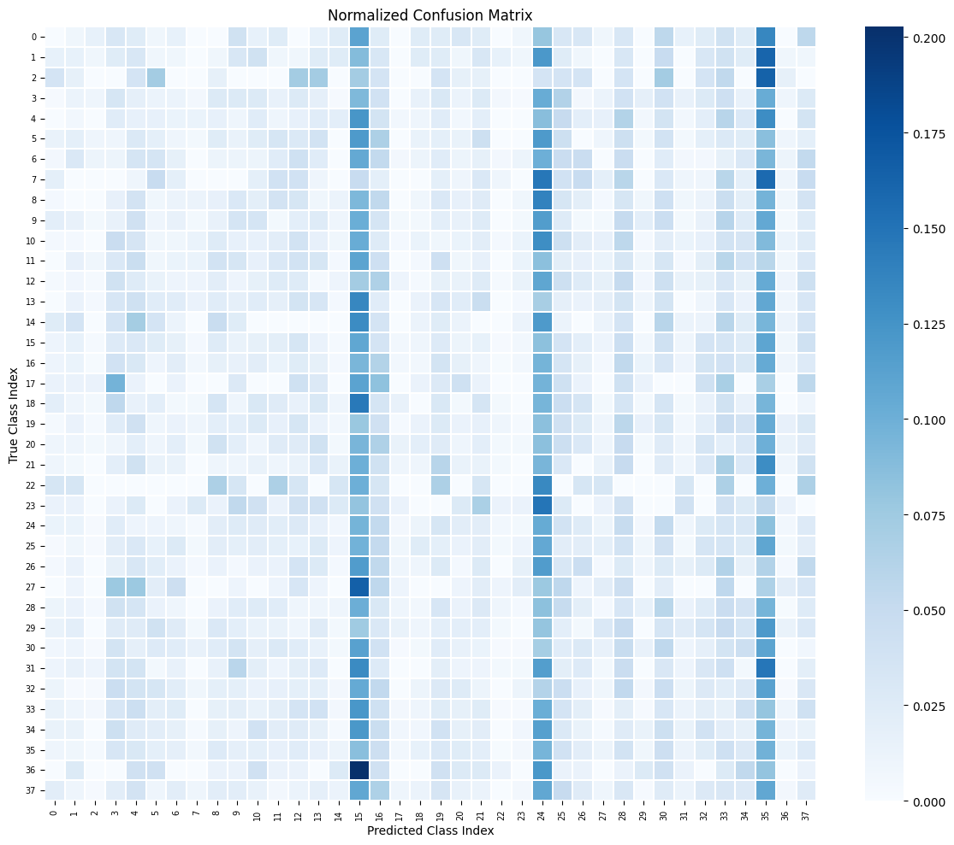
Result & Discussion(Cont.)
Shows comparison between actual and predicted classes
Darker diagonal values indicate correct predictions
Lighter off-diagonal values show minor misclassification
Overall pattern confirms good model performance
Confusion Matrix

Slide 15
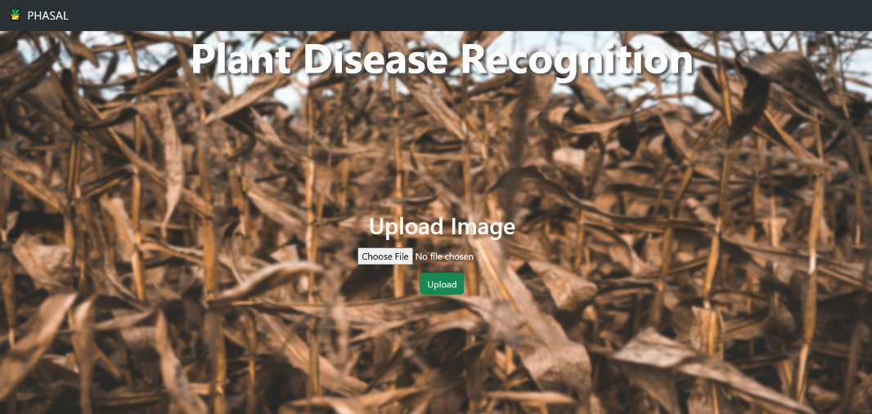
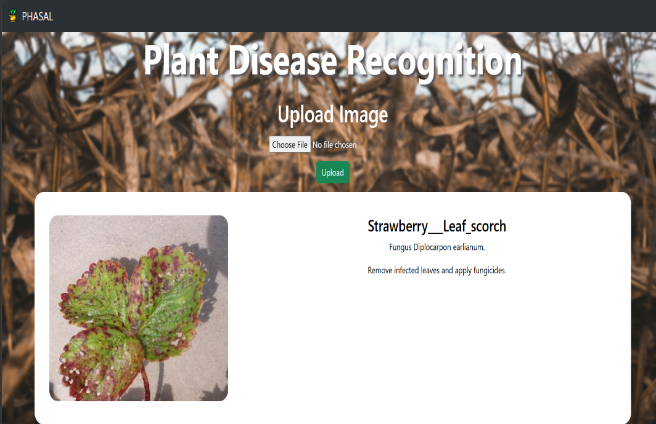
Web Interface
After choosing the image
Prediction Page

Slide 16
Conclusion & Future Work
Conclusion
A CNN-based plant disease detection model was developed using the PlantVillage dataset.
The model accurately classifies healthy and diseased plant leaf images.
A Flask web application enables simple and real-time disease prediction.
The system supports early disease identification, helping reduce crop loss and improve productivity.
Future Work
Improve accuracy using advanced CNN models and transfer learning techniques.
Train the model with real-world field images for better generalization.
Deploy the system as a mobile or cloud-based application for wider access.
Expand the dataset to include more crops and disease categories.

Slide 17
References
Dubey, S. R., Jalal, A. S., et al., “Detection and Classification of Apple Fruit Diseases Using Local Binary Patterns,” International Journal of Computer Applications, vol. 97, no. 8, pp. 6–10, 2014.
Revathi, P., Hemalatha, M., et al., “Classification of Cotton Leaf Spot Diseases Using Image Processing Techniques,” International Journal of Engineering Research and Technology (IJERT), vol. 1, no. 6, 2012.
Pujari, R. S., Mytri, V. D., et al., “Detection of Plant Diseases Using Image Processing Techniques,” International Journal of Innovative Research in Computer Science & Technology, vol. 3, no. 3, pp. 12–17, 2015.
Kamble, A., Pawar, A., et al., “Crop Disease Detection Using Convolutional Neural Networks,” International Journal of Advanced Research in Computer Science, vol. 9, no. 2, pp. 287–290, 2018.
Patil, S., Kumar, R., et al., “Plant Disease Detection Using Deep Learning Techniques,” International Journal of Engineering and Advanced Technology (IJEAT), vol. 8, no. 4, pp. 135–139, 2019.

Slide 18
Thank You

